Slide 1

In with the Old,
Out with the Young:
STELLAR CLUSTERS in NGC 3344
ASU/NASA
NAOMI CARL
Mansi Padave. Sanchayeeta Borthakur.
ASU/NASA Space Grant Program

Slide 2
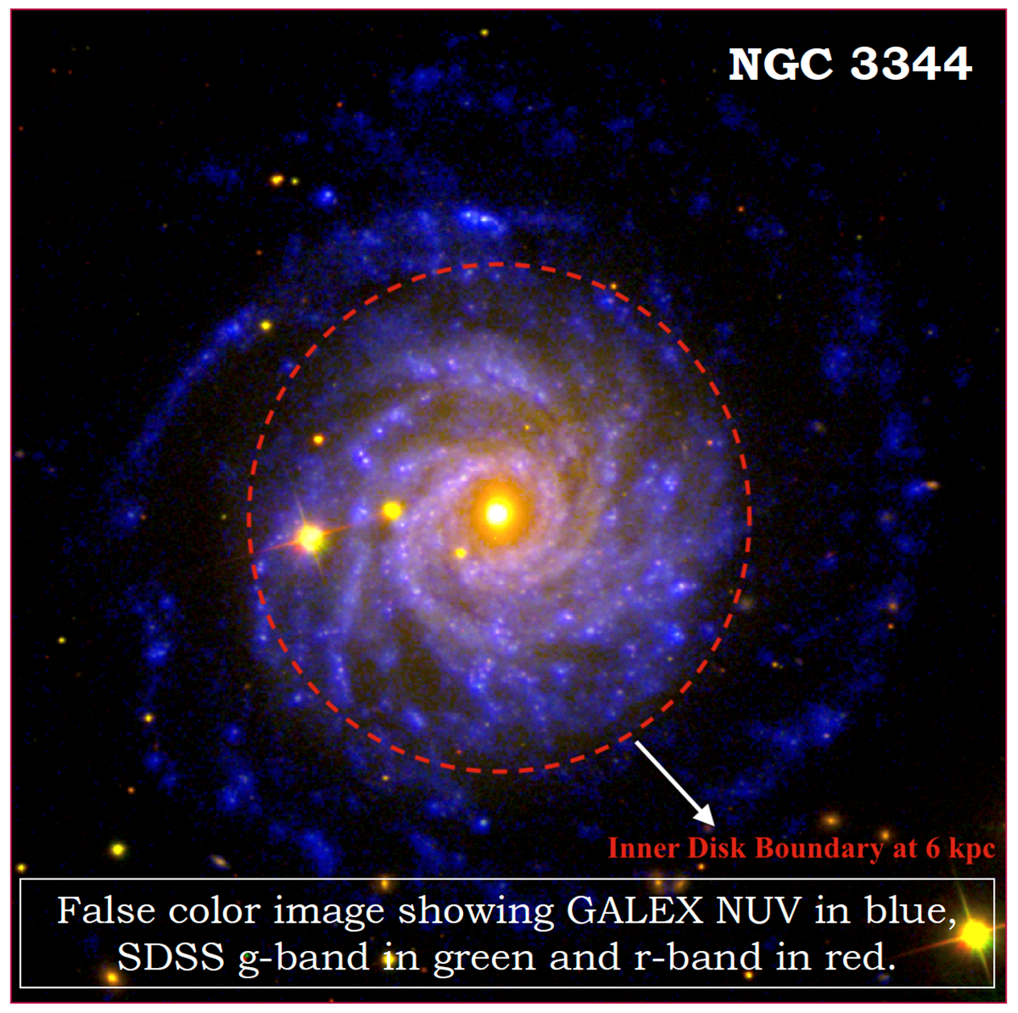
INTRODUCTION
Objective: Study growth of stellar disks in nearby galaxies
  Investigate properties of stellar associations in galaxies
  Examine how stellar associations vary in the inner versus outer disk
Data:
  Large Binocular Telescope
  Bessel-U, Sloan-g, Sloan-r
Sample:
  NGC 3344
  This galaxy has a quasar behind its CGM and is face-on

Slide 3


METHODOLOGY
DETECT CLUSTERS
EXAMINE COLORS
Clusters were identified from the U and r bands through Source Extractor
The color was plotted as a function of galactocentric distance
02
01
03
CALCULATE MAGNITUDE
The magnitudes from each band are subtracted to form colors

Slide 4
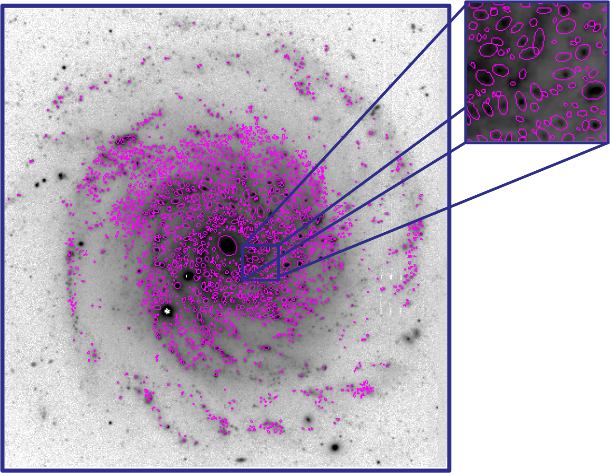
RESULTS
1500+ SOURCES
Sources are circled using elliptical apertures
MAGNITUDE
This data allows us to calculate magnitude of the U-band and r-band

Slide 5
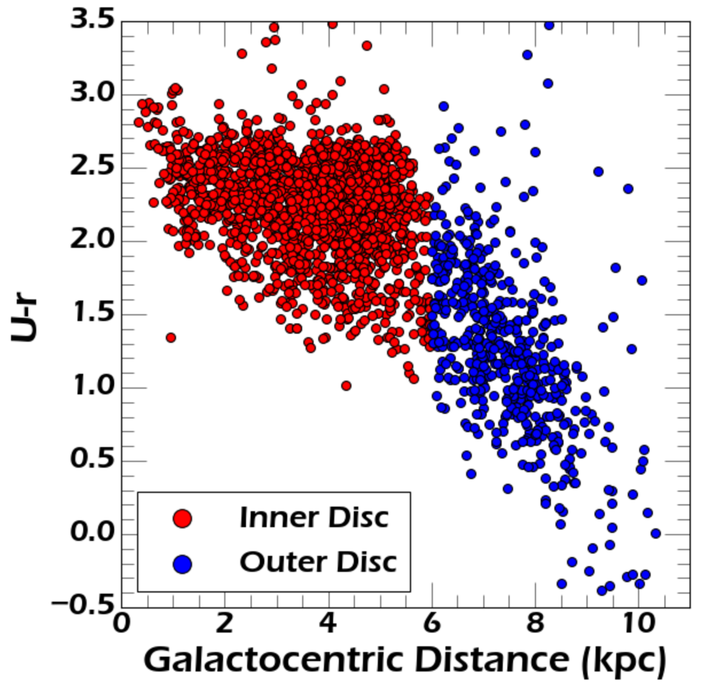
RESULTS
COLOR
The difference in magnitudes gives us the approximate age of the stars
TRENDS
U-r color decreases as a function of distance.
Slope beyond 6 kpc is approximately 15% steeper

Slide 6

CONCLUSIONS & FUTURE WORK
The color graph shows older stars are more present in the inner disk
AGE GRADIENT
More young stars in the outer disk means the galaxy is growing “inside-out”
INSIDE-OUT
Investigating the star formation history of the galaxy
FUTURE WORK

